Slide 1
BUSINESS CONTINUITY DATA RECOVERY
PRESENTED BY
NAGENDRA (11)
SAI VENKATA NIKHIL (17)
VEGAPATEL (13)

Slide 2
INDEX
Contents | Slide Number
Business Continuity Planning | 03
Key Elements of BCP | 04
Functions of BCP Systems | 07
BCP Software Screenshots | 10

Slide 3
What is Business Continuity Planning (BCP) ?
Planning to ensure the continuation of operations in the event of a catastrophic event.
Business continuity planning goes beyond disaster recovery planning to include:
• The actions to be taken
• Resources required, and
• Procedures to be followed to ensure the availability of essential services, programs, and operations in the event of unanticipated interruptions.

Slide 4
Key Elements (BCP)
Disaster Recovery
Business Recovery
Contingency Planning
Crisis Management

Slide 5
Why should we do Business Continuity Planning ?
It ensures compliance with our ever increasing regulatory requirements
It enhances our ability to avoid:
Interruptions to business
Financial losses
Regulatory fines
Damage to equipment

Slide 6
List Of Selected BCP Systems
Clearview
EzBackup
eVault
Datto
BCMfort
Service Now Security Operations
VMware Virtual Center
http://www.capterra.com/business-continuity-software/

Slide 7
Functions of BCP Systems
System | Function
Clearview | Clear View represents Making the Complicated Simple of BCM platform which is rapidly being adopted world-wide. Modern yet proven, it helps clients comply with BCM best practice while facing the inevitable need for greater cost-efficiencies
EzBackup | Automated backup Flexible Schedules User File Recovery Automated Monitoring
eVault | Military-grade, end-to-end encryption protects your data every step of the way Controlled data access means you alone own the encryption key Agent-initiated backups ensure all operations are authorized and authenticated
Datto | Instant On-site/Off-site virtualization Centralized Management Screenshot backup verification

Slide 8
Functions of BCP Systems
System | Function
BCMfort | Risk Assessment Powerful Dashboard Improved Modules Enhanced Security
Service Now Security Operations | Deliver Efficient Security Response Streamline Remediation Clearly Visualize Security Posture
VMware Virtual Center | High availability Migration of live Operational automation Secure access control

Slide 9
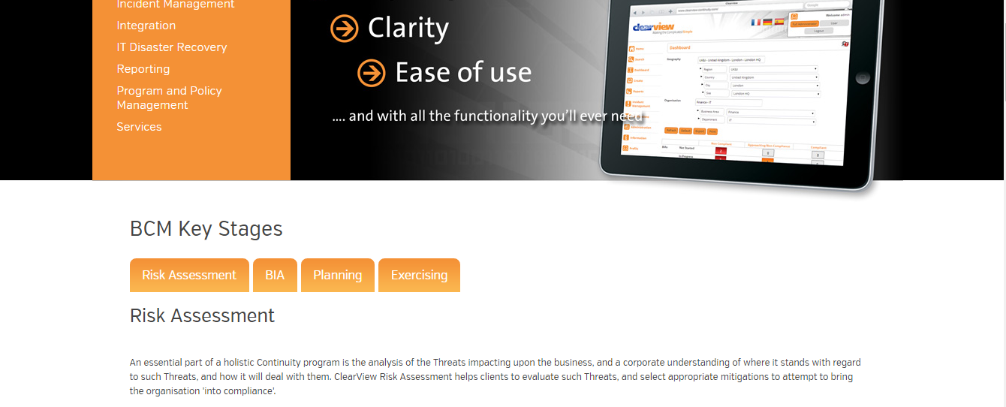
Clearview System

Slide 10
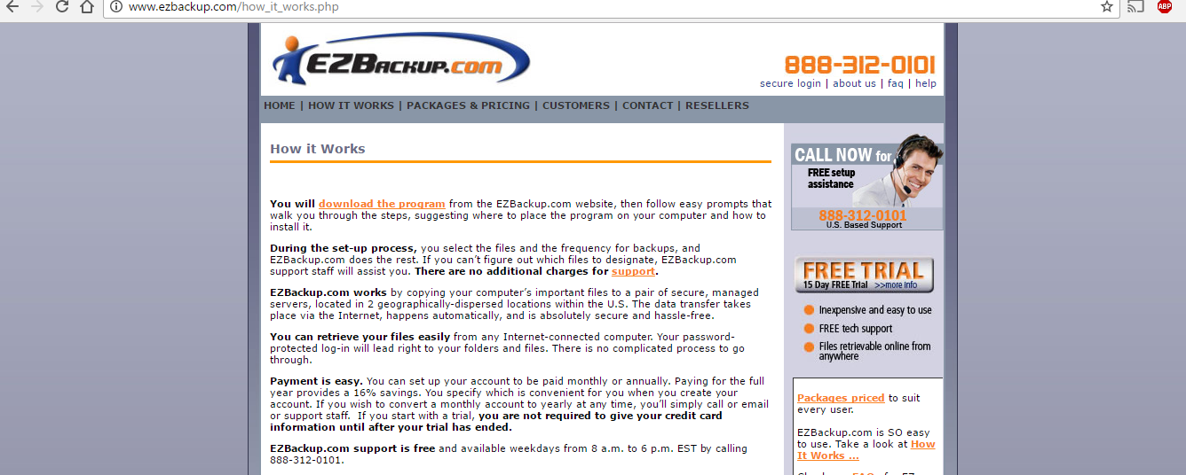
EzBackup System

Slide 11
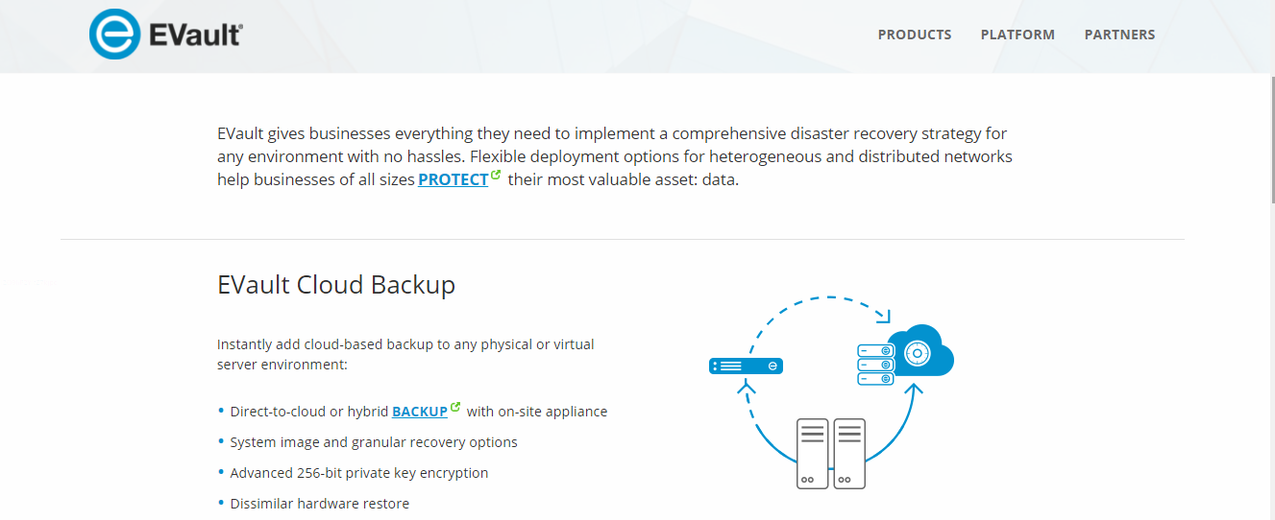
Evault system

Slide 12
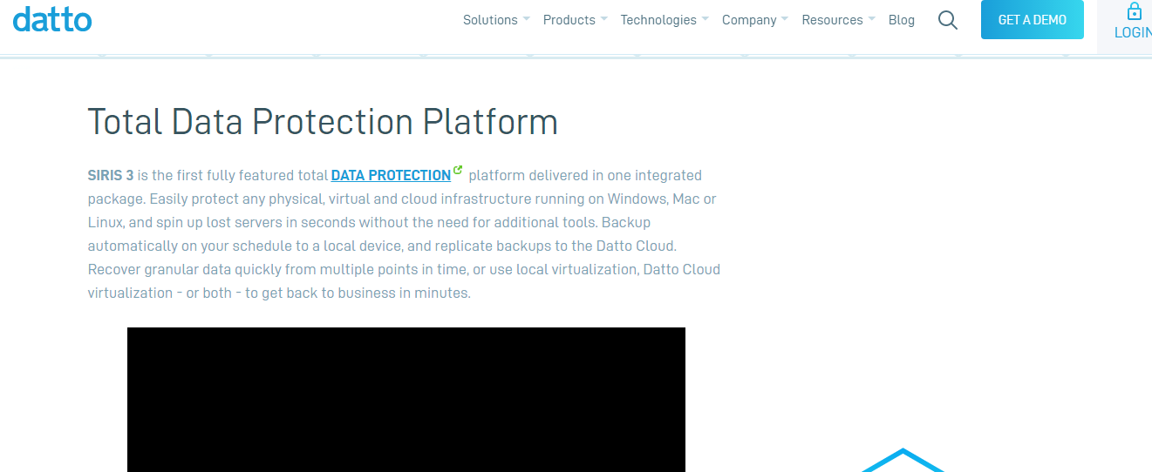
Datto System

Slide 13
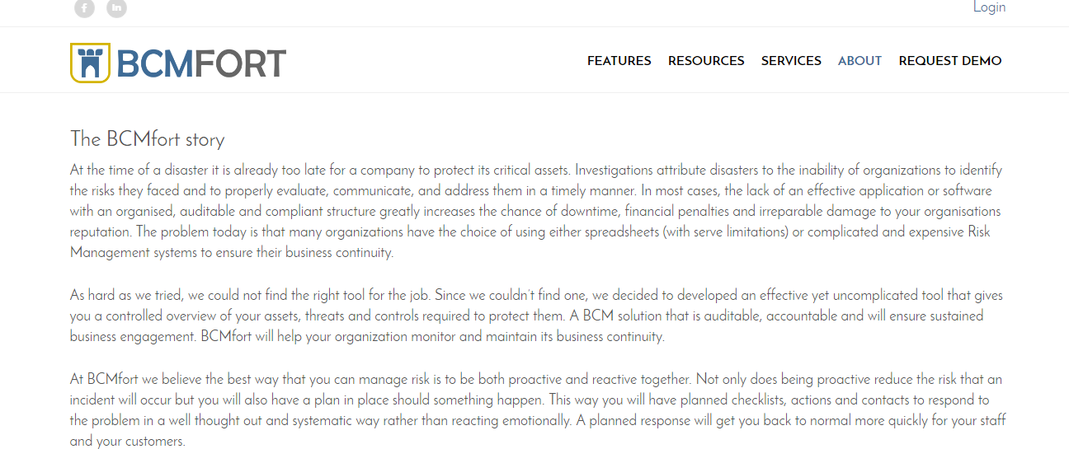
BCMfort System

Slide 14
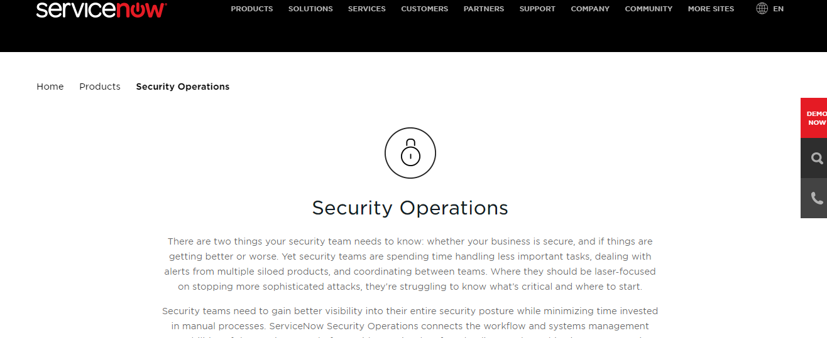
Service Now Security Operations

Slide 15
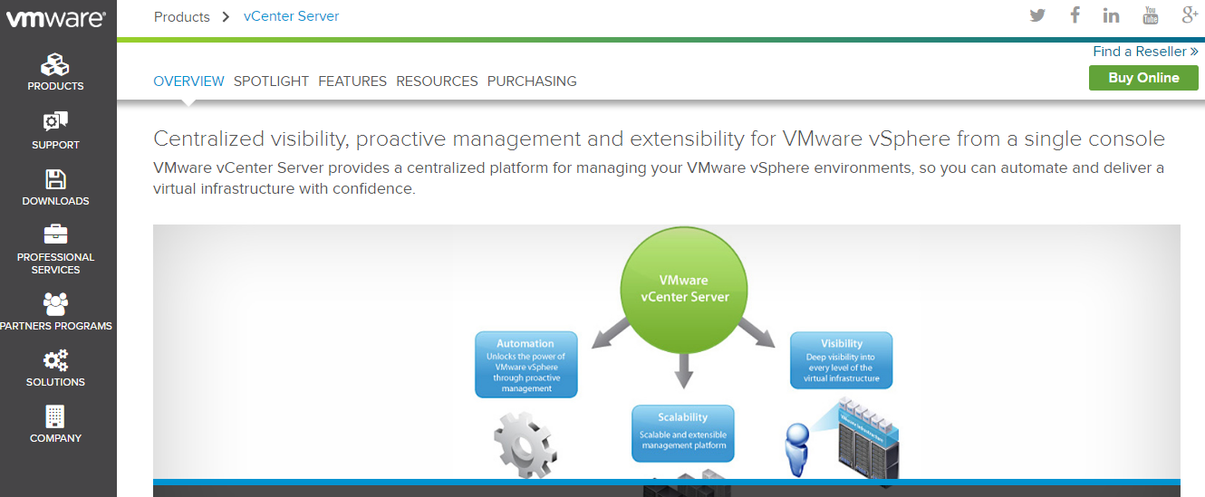
VMware Virtual Center

Slide 16
Thank You !

